Slide 1
What happened in England in 1381?

Slide 2
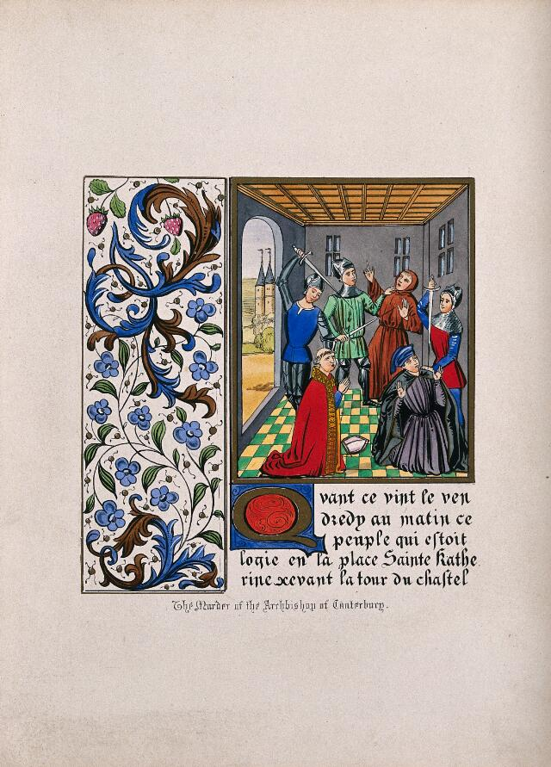

Look at this image.
What is happening?
Original image
A
Notes:
This is an image made in 1845, but taken from material in the Chronicles from Jean Froissart, one of the key contemporary accounts of events of 1381 (see teacher guide for more information about the contemporary chronicles and challenges when using them).
Image: The murder of Simon Sudbury at the Tower of London in 1381. Coloured lithograph. Wellcome Collection. Public Domain Mark, https://wellcomecollection.org/works/jtv29zvm
From the Wellcome Collection: Simon of Sudbury, Archbishop of Canterbury, was killed in the Peasants’ Revolt. He was dragged from the Tower of London to Tower Hill nearby and beheaded. ‘They also murdered the Prior of St John’s, and a Franciscan friar, a doctor of physic, as represented in the illumination’ (Humphreys, loc. cit.). In the present depiction two of the turrets of the Tower of London are shown in the left background.

Slide 3
Where is it?
What type of people are these?
What type of people are these?
What is this gesture?

Slide 4
This illumination is from chronicles by Jean Froissart.
This shows the murder of Simon of Sudbury, Lord Chancellor and Archbishop of Canterbury. He was dragged from the Tower of London to Tower Hill nearby and beheaded. The Prior of St John’s and a Franciscan friar were also murdered.
Notes:
Illumination: picture or illustration from a book
Chronicles: a book with a record of events, year by year, usually written at the time or shortly afterwards; they are not as impartial as we would expect history books to be today
Archbishop: an important leader in the Christian church
Lord Chancellor: key person at court, organising the King’s letters and most senior judge after the King
Prior: head of a monastery
Franciscan friar: a type of monk, who often lived in poverty
This is a violent image. If it is not suitable for your group, you could substitute Source B instead. The Tower of London is shown in the background. The source has been selected to get students thinking about the seriousness of events in 1381. It is also potentially a bit of a red herring – students may think back to Becket (if you have covered that).

Slide 5
What happened in England in 1381?
Do you have any initial ideas?
Why would people kill Simon Sudbury?

Slide 6
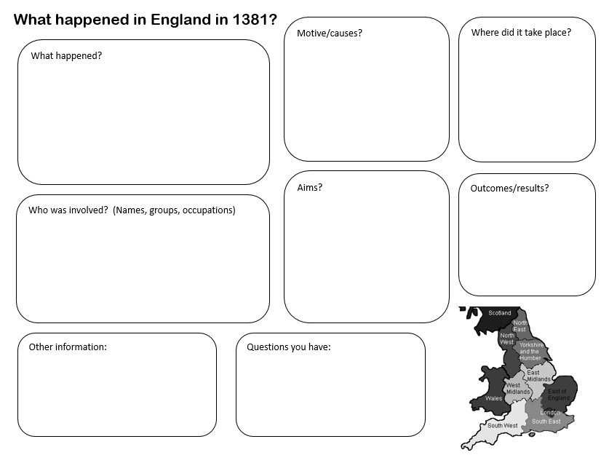

What happened in England in 1381?
What happened in England in 1381?
During today’s lesson, you will be researching events of 1381 using a series of different sources and interpretations.
We will record our findings on this worksheet.
Let’s start with the first item that we have used as evidence.
Notes:
This is designed to be a working document, so students don’t need to worry about crossing things out, etc. The first item used as evidence is the Froissart picture. NB: The sources and the interpretations are being used to yield evidence. This distinction is important for students to learn. Depending on how familiar your students are with these terms, you may need to do some reinforcement.

Slide 7
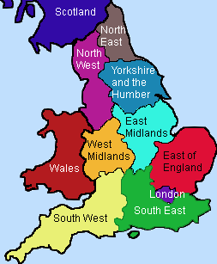
What happened in England in 1381?
Motive/causes?
Where did it take place?
What happened?
Aims?
Outcomes/results?
Who was involved? (Names, groups, occupations)
Other information:
Questions you have:
Notes:
Map: https://cutewallpaper.org/32x/iwwtsr9t9/1949312060.html

Slide 8
What happened in England in 1381?
Motive/causes?
Where did it take place?
What happened?
London
The Lord Chancellor was killed
Aims?
Outcomes/results?
Who was involved? (Names, groups, occupations)
Other information:
Questions you have:
Notes:
Worked example of how to record evidence. This activity does not include analysis about the reliability of sources and interpretations as evidence. This is covered in the optional ‘chronicles’ section of Lesson 2.

Slide 9
What happened in England in 1381?
Historians use as many sources and interpretations as they can as evidence, in order to work out what happened in the past.
Today you will be historians!
In this lesson, we will be using lots of sources and interpretations as evidence to find out what happened in 1381.
Notes:
Tentative: not certain

Slide 10
What happened in England in 1381?
Let’s have a look at another source of evidence – this is taken from a chronicle from the time.
We’ll put our findings onto the sheet.
Notes:
Chronicle: contemporary account or record of events

Slide 11
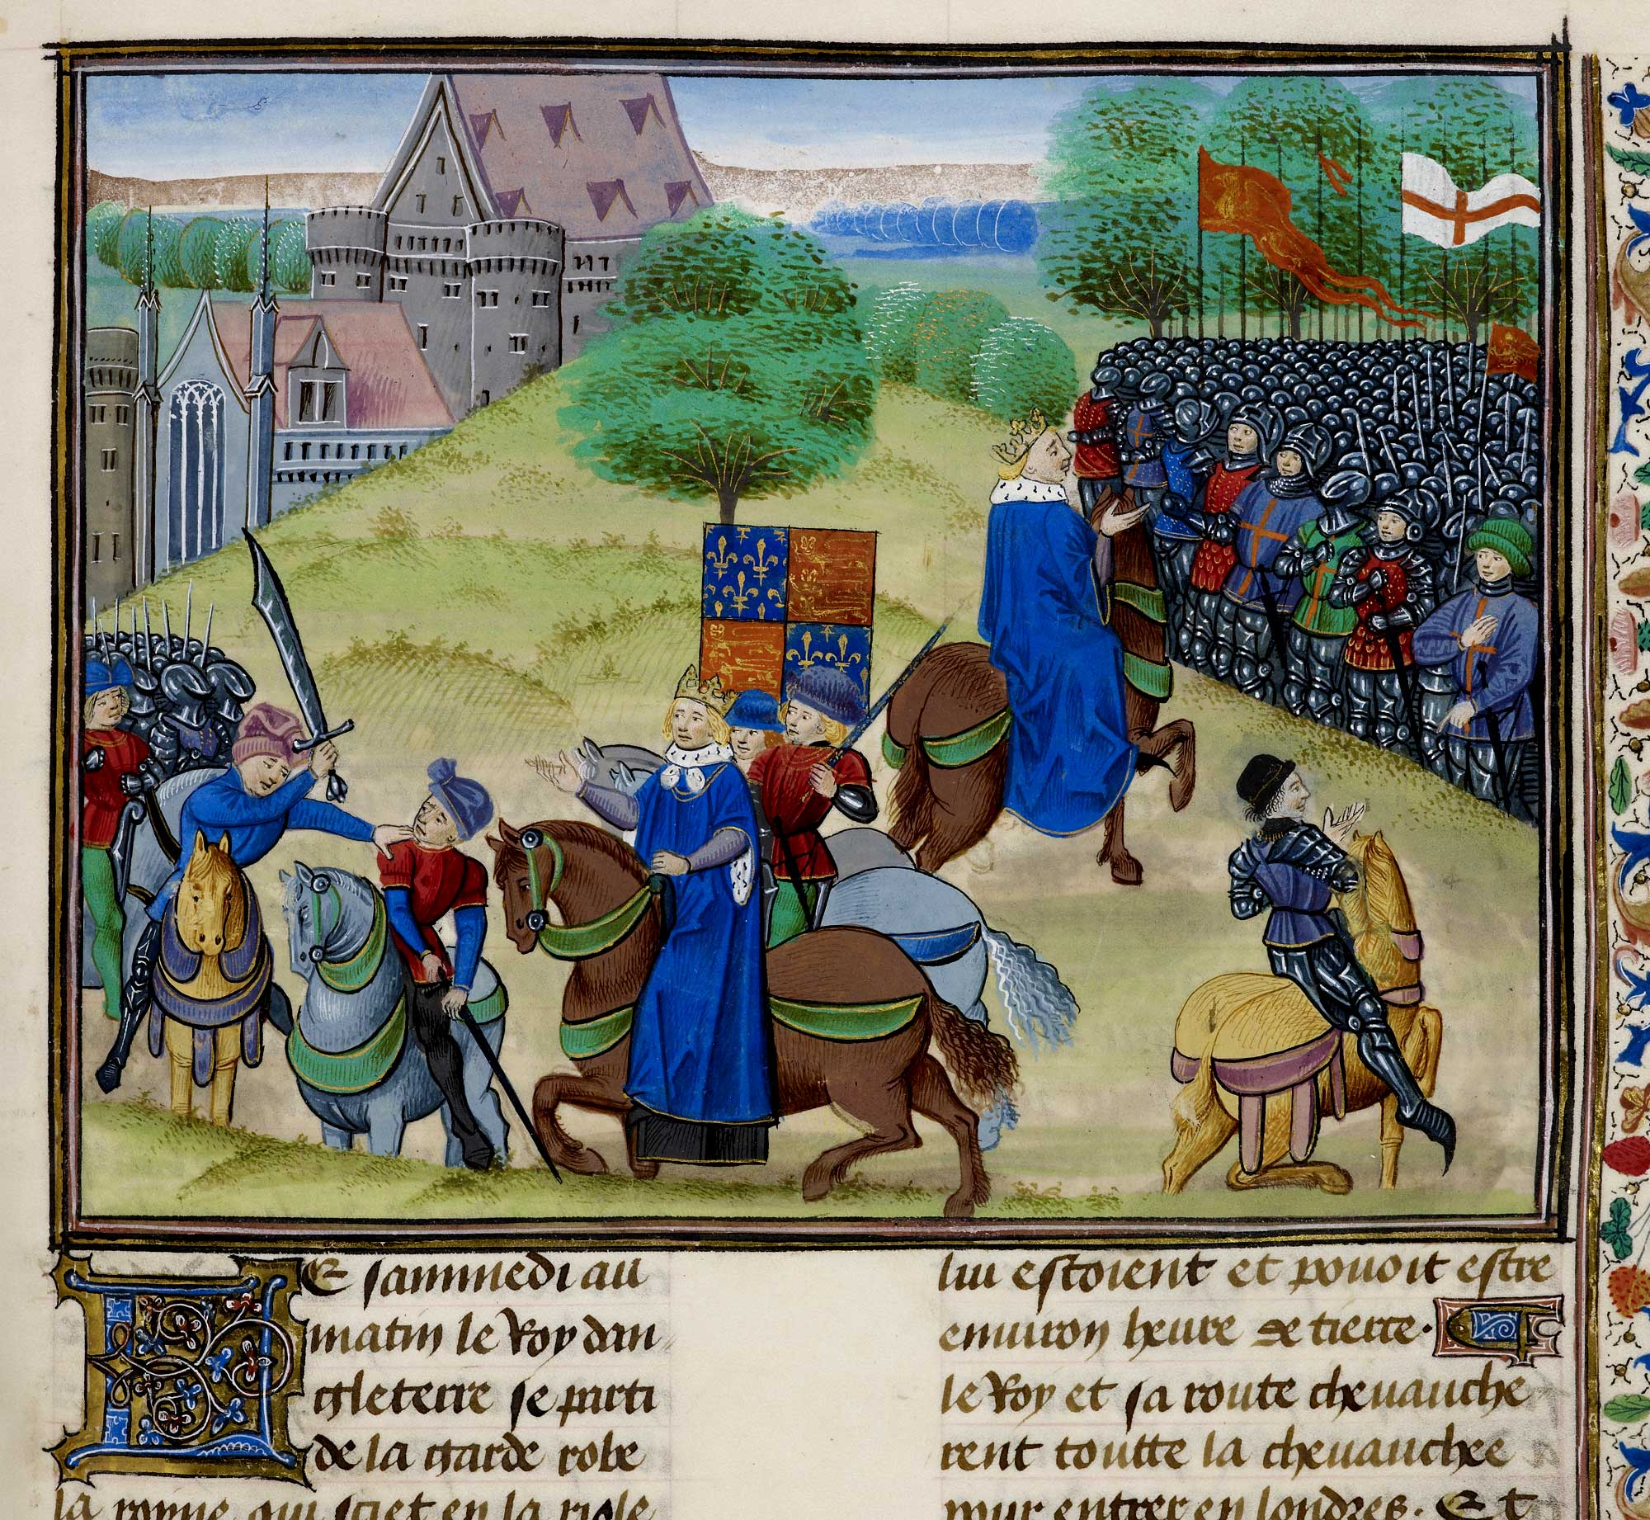
This illumination from Chronicles by Jean Froissart actually shows two scenes from the same event. On the left is the first scene and the second is on the right.
Original image
B
Notes:
Image: © The British Library Board, www.bl.uk/learning/timeline/item132518.html
The Peasants’ Revolt – Froissart, Chroniques de France et d’Angleterre, Book II (c.1460–1480) (Royal MS 18 E I f.175.)

Slide 12
Who is the figure in the blue cloak?
What flags can you see?
Who are the groups of people?
Notes:
Interactive task on BBC website for this source: https://www.bbc.co.uk/bitesize/topics/z93txbk/articles/zyb77yc

Slide 13
This shows King Richard II.
In the first scene, one of the leaders, Wat Tyler, is about to be killed by the Mayor of London, William Walworth.

Slide 14
In the second scene, the King is pleading with people to be peaceful and return to their homes.

Slide 15
What happened in England in 1381?
Motive/causes?
Where did it take place?
What happened?
What have you found out?
Aims?
Outcomes/results?
Who was involved? (Names, groups, occupations)
Other information:
Questions you have:

Slide 16

What happened in England in 1381?
Now you will work in pairs/groups and use sources and interpretations as evidence to find out more about the events of 1381.
Be prepared to share your findings with the rest of the class.
We might not be able to fill in all of the boxes, and sometimes we might not be certain about what we find out. This is what historians often experience when carrying out their research too.
Notes:
Sources and interpretations can be found in the separate document ‘Evidence pack’. The sources and interpretations are included at the end of the PowerPoint (hidden slides), should you wish to go through any as a whole class. The sources and interpretations are very broadly arranged in terms of challenge.

Slide 17
What happened in England in 1381?
Motive/causes?
Where did it take place?
What happened?
What have you found out?
Aims?
Outcomes/results?
Who was involved? (Names, groups, occupations)
Other information:
Questions you have:

Slide 18
What happened in England in 1381?
Motive/causes?
Where did it take place?
What happened?
Long-term: Black Death, labour laws (C)
War with France, settle scores (C)
Poll tax (D)
Government spending (I)
Anger at John of Gaunt (I)
London (A, B, E)
Essex and Kent (I)
Simon Sudbury was killed (A)
The King met with the rebels (B)
The Savoy Palace was destroyed (D)
Wat Tyler was killed in a confrontation with the Mayor of London (K)
Peasants destroyed records (L)
Aims?
Outcomes/results?
Who was involved? (Names, groups, occupations)
Peasants wanted equality (F, G)
Peasants were executed (H)
Some peasants were pardoned – had to pay for the pardon (J)
King Richard II
Simon Sudbury, Lord Chancellor
Wat Tyler
Peasants
John of Gaunt, Duke of Lancaster
John Ball
Other information:
Questions you have:
Notes:
Worked example included for reference

Slide 19
What happened in England in 1381?
Motive/causes?
Where did it take place?
Still have some gaps? Ideas changed? This is what happens for historians too! Next lesson, we will do some more in-depth research to fill in these gaps.
What happened?
Aims?
Outcomes/results?
Who was involved? (Names, groups, occupations)
Other information:
Questions you have:
Notes:
It is likely that students will have gaps and questions about events – these will provide a focus for the next lesson.

Slide 20

What happened in England in 1381?
What do you think this event is called?
The event that we are looking at is commonly known as the Peasants’ Revolt.
Do you think that this is what it should be called?
Notes:
Here, we are really aiming for students to think about how events can be interpreted differently over time: many historians today, for example, would not think that ‘Peasants’ Revolt’ is an accurate name to describe the events of 1381. That is because people from across society (from the gentry ‘down’) and from towns as well as countryside were involved. However, others argue that because England was an agrarian (peasant) economy, this remains a useful term.

Slide 21

What happened in England in 1381?
This short animation will recap what we have learnt today.
If there is any new information, you can add this to your sheet.
Notes:
Video: https://www.bbc.co.uk/bitesize/topics/z93txbk/articles/zyb77yc

Slide 22
We looked at this image at the start of the lesson.
Can you explain what is happening?
What had happened before? What happened afterwards?
Are there still things that we need to find out....
Notes:
Simon Sudbury was singled out because of his role of Lord Chancellor, and thus being associated with orders going out about the unpopular poll taxes.

Slide 23
What happened in England in 1381?
So what happened in 1381?
Can you summarise it in a paragraph?
How would you explain it to other people?
Notes:
At this point, you may want to discuss more about how and why interpretations change over time in general terms, in order to prepare the ground for the next lesson.

Slide 24
What happened in England in 1381?
Today we’ve looked at the traditional interpretation of the Peasants’ Revolt. Key parts of it are:
There were a variety of causes
The leaders were Wat Tyler and John Ball
They had no clear aim
The peasants rebelled violently against the King
It was mainly in London
It was widespread and serious
It was unsuccessful

Slide 25
What happened in England in 1381?
Next lesson, we will look at more recent research from historians and see how this changes the traditional interpretation.

Slide 26
Original image
A
Notes:
An image made in 1845, but taken from material in the Chronicles from Jean Froissart, one of the key contemporary accounts of events of 1381 (see teacher guide for more information about the contemporary chronicles and challenges when using them). Rebels have broken into the Tower of London and are about to kill Simon Sudbury, Lord Chancellor. He was singled out because of the rebels' anger at the poll taxes.
Image: The murder of Simon Sudbury at the Tower of London in 1381. Coloured lithograph. Wellcome Collection. Public Domain Mark, https://wellcomecollection.org/works/jtv29zvm
From the Wellcome Collection: Simon of Sudbury, Archbishop of Canterbury, was killed in the Peasants’ Revolt. He was dragged from the Tower of London to Tower Hill nearby and beheaded. ‘They also murdered the Prior of St John’s, and a Franciscan friar, a doctor of physic, as represented in the illumination’ (Humphreys, loc. cit.). In the present depiction two of the turrets of the Tower of London are shown in the left background.

Slide 27
This illumination from Chronicles by Jean Froissart actually shows two scenes from the same event. On the left is the first scene and the second is on the right.
Original image
B
Notes:
Image from Froissart’s Chronicles. Wat Tyler has become the ‘leader’ of the Revolt, although it is unlikely that there was one single leader. There is much uncertainty about what actually happened at this meeting in Smithfield.
Image: © The British Library Board, www.bl.uk/learning/timeline/item132518.html
The Peasants’ Revolt – Froissart, Chroniques de France et d’Angleterre, Book II (c.1460–1480) (Royal MS 18 E I f.175.)

Slide 28
Here are some long-term causes that historians have suggested:
The Black Death (1349) had killed so many people that there was a shortage of workers.
Worried lords tried to use new laws (1351) to stop workers leaving or demanding higher wages.
Many peasants had to go to fight in the wars against France, leaving behind their homes and families.
Some peasants wanted a chance to get rid of people whom they hated, like lawyers and some churchmen.
C
Notes:
History textbooks have often suggested a link between the consequences of the Black Death and the causes of the Revolt, but it must be remembered that the Black Death happened decades earlier, and there were much more pressing concerns faced by people in 1381.

Slide 29
From a modern textbook:
There had been several new taxes.
The most hated was the poll tax.
This had to be paid by everyone (not just one household), which was different to previous taxes.
It also had to be paid by everyone over the age of 15.
It was set at one shilling – about two weeks’ work for a peasant. All people had to pay the same amount.
D
Notes:
There were actually three poll taxes – each one successively more punishing on the people. There was mass evasion of the tax. The poll tax was never raised again until the time of Margaret Thatcher in 1990, when it was once again met with riots.

Slide 30
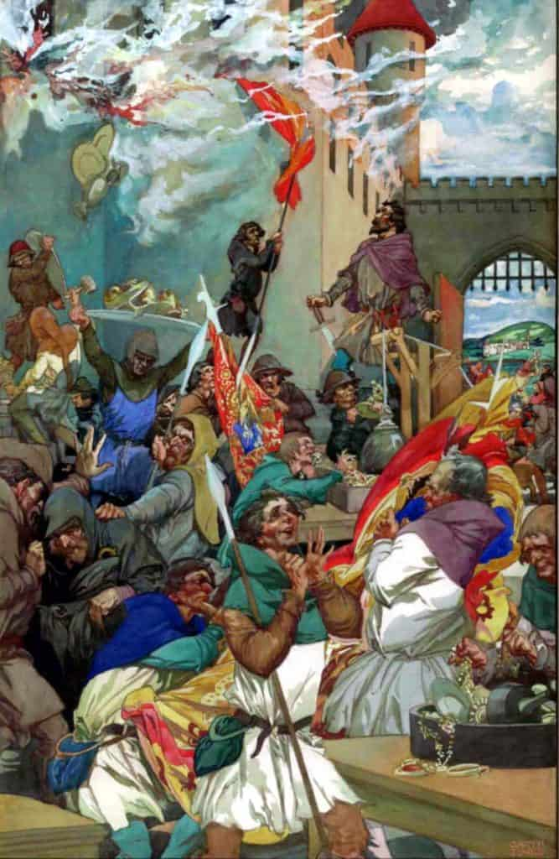
The burning of the Savoy Palace in London. It was owned by John of Gaunt, Duke of Lancaster.
Painted by Alfred Garth Jones, c. 1900
John of Gaunt, Duke of Lancaster, was uncle to the king, a powerful noble. He was incredibly rich and owned lots of land across England. Some thought he wanted to be king himself.
E
Notes:
John of Gaunt was a key focus for the rebels. He was away in Scotland at the time; otherwise, it is highly likely that he would have been in real danger. He was blamed for the bad decisions that the government made, and not the young King Richard (his nephew). It was the Victorians who really began to call the event the ‘Peasants’ Revolt’.
Image: https://commons.wikimedia.org/wiki/File:Alfred_Garth_Jones_Peasants_Revolt.jpg
The rebels during the Peasants’ Revolt burn Savoy Palace, 1381. The king’s uncle John of Gaunt was blamed for the poll tax that was the spark that led to the revolt. When the rebels reached London, they burned down his home at Savoy Palace. Henry VII later left instructions in his will that the home be turned into a hospital for the needy, which was established in 1512. By Alfred Garth Jones, ca. 1900. Wikimedia Commons. (From: https://historycollection.com/reason-englands-first-major-revolution/3/)

Slide 31
From History of England, a chronicle by Thomas Walsingham.
The King’s words to the Essex peasants:
Oh you wretched men. You who want to be equal with your lords are not worthy to live. Villeins you were and villeins you shall remain.
F
Wretched: miserable, inferior
Villein: a peasant who isn’t free – he owes something (e.g. labour) to the local lord
Notes:
See the section on chronicles in Lesson 2 for more information about Walsingham. He was a monk at St Albans and was very hostile to the rebels.

Slide 32
From Chronicles by Jean Froissart:
These evil creatures in the counties became presumptuous. They said their servitude was too harsh and that there were no serfs when the world began. They had been much stirred up in these lunatic ideas by a mad priest called John Ball.
‘Good people,’ he would say, ‘nothing can go well in England, nor ever will do, until all goods are held in common, until there is neither villein nor nobleman.’
G
Servitude: owing something to someone else – a form of slavery
Serf: a peasant who wasn’t free, e.g. had to ask lord for permission to leave the village – a form of slavery
Notes:
Servitude: owing something to someone else – a form of slavery
Serf: a peasant who wasn’t free, e.g. had to ask lord for permission to leave the village – a form of slavery
John Ball was preacher and often put forward, like Tyler, as one of the key influences on the Revolt. Like Tyler, we know very little about him at the time of the Revolt. He was caught and executed.

Slide 33
From the chronicle by Henry Knighton, written in 1381:
Judge Tresillian spared no one. Peasants accused of rebellion, whether justly or out of hatred, were beheaded, hung or drawn and quartered. John Ball was drawn and quartered. His intestines were cut out and burned while he was still alive. Then he was hung and his body cut into four. Pieces were sent to be put on show in different places in the kingdom.
H

Slide 34
From Anonimalle Chronicle:
At this time the commons of the southern England suddenly rose in two groups, one in Essex and the other in Kent. They directed their evil actions against the duke of Lancaster and the other lords of the realm because of the exceptionally severe tenths and fifteenths and other subsidies lightly conceded in parliaments and extortionately levied from the poor people. These subsides did nothing for the profit of the kingdom but were spent badly and deceitfully to the great impoverishment of the commons – and it was for this reason, as you will now hear, that the commons rose.
John of Gaunt, Duke of Lancaster, was uncle to the King, a powerful noble. He was incredibly rich and owned lots of land across England. Some thought that he wanted to be king himself.
Subsidies: taxes
I
Notes:
Taken from pp. 133–140
Textbooks often focus on the Revolt in the South East and London, but it was much more widespread. There is a section in Lesson 2 with more detail on this. The Revolt did not end in London: there continued to be sporadic outbreaks across the country. It is also worth noting that the population density of England was different at this time – London and the South East were important for trade. East Anglia was also relatively populated for the time. The North West was relatively less populated.

Slide 35
From Anonimalle Chronicle:
Afterwards the King sent out his messengers to capture the wrongdoers and put them to death. Many were taken and hanged at London, and they set up many gallows around the City of London, and in other cities in the south. At last the King seeing that too many of his subjects would be undone and too much blood spilt, took pity. He granted them all pardon, on condition that they should never rise again, under pain of losing life or limb. Each man should get his charter of pardon, and pay the King a fee of twenty shilling, to make him rich.
J
Gallows: places where people were hung/executed
Notes:
Many pardons were granted.

Slide 36
From Froissart’s Chronicles:
Wat Tyler spurred his horse and came close to the King. Then he said, ‘Do you think, King, that these people will go away from you without having your signed guarantees*?’ ‘No,’ said the King, ‘you shall have them. They are ordered for you and shall be given to every one. So, good fellows, go back to your people and get them to leave London.’
Wat Tyler cast his eyes on a squire who was there carrying the King’s sword. Wat Tyler hated that squire because he had annoyed him before. ‘Give me that sword,’ said Tyler. ‘No,’ said the squire. ‘It is the King’s sword. You are not fit to have it for you are only a knave.’ ‘By my faith,’ said Tyler, ‘I shall never eat meat until I have your head.’
At that moment the Mayor of London arrived with twelve knights, all well-armed, and broke through the crowd. He said to Tyler, ‘Ha! Would you dare to speak like that in front of the King?’ The King began to get angry and told the Mayor, ‘Set hands on him.’ Tyler said to the Mayor, ‘What have I said to annoy you?’ ‘You lying, stinking, crook,’ said the Mayor, ‘would you speak like that in front of the King?’ By my life, you’ll pay dearly for it.’
And the Mayor drew out his sword and struck Tyler such a blow on the head that he fell down at the feet of his horse. The knights clustered round him so he could not be seen by the rebels. Then a squire called John Standish drew out his sword and put it into Tyler’s belly and so he died.
Seeing their leader killed, the people began to murmur and said ‘Let’s go and kill them all.’ And they got themselves ready for battle.
The King road alone to these people and said, ‘Sirs, what is the matter? You shall have no leader except me. I am your king. Be peaceful.’
Most of the people were ashamed and began to leave.
*The guarantees were written promises that the King would give the peasants their freedom and they would not be punished.
Squire: a type of servant
Knave: dishonest person
K

Slide 37
From Henry Knighton’s chronicle:
The rebels returned to the New Temple which belonged to the prior of Clerkenwell... and tore up with their axes all the church books, charters and records discovered in the chests and burnt them…One of the criminals chose a fine piece of silver and hid it in his lap; when his fellows saw him carrying it, they threw him, together with his prize, into the fire, saying they were lovers of truth and justice, not robbers and thieves.
L
Clerkenwell and New Temple are both places in London.
Notes:
One of the key actions of the rebels was destroying records, often (but not exclusively) tax records. Issues about rights and land ownership were also important. This suggests that the rebels were more sophisticated and organised than traditionally thought. Their disruption was well targeted and they had enough literacy and knowledge of systems to know how to be disruptive.

Slide 38
Optional challenging sources

Slide 39
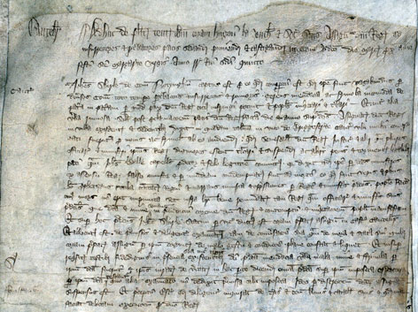
Pleas held before Hugh la Zouche and his associates, justices of the lord king appointed to subdue, punish and chastise rebels and disturbers of the peace in the aforesaid county [Cambridgeshire] on Tuesday immediately before the feast of St Margaret the Virgin, in the fifth year of the reign of King Richard the Second [16 July 1381]:
John Shirley of the county of Nottingham was arrested on the grounds that he was clearly wandering through divers counties at the time of the [recent] disturbance, rebellion and mayhem, spreading lies and falsehoods from region to region, likely to cause trouble and to breach the king’s peace and alarm and disturb the people, and for making derogatory statements after the proclamation of the king’s peace on the abovementioned day and year. While the justices of the lord king were present and resident in the town, he said in an inn in Bridge Street in Cambridge, where many people had gathered to hear fresh falsehoods from him, that the stewards of the lord king, his justices and many of his officials were more worthy to be drawn and hanged and suffer the other punishments and tortures prescribed by the law than the priest, John Ball, who had been convicted by law as a traitor and a felon, because he said that [Ball] had been condemned to death by the said ministers, with the assent of the king, falsely, unjustly and maliciously, simply for being a true and honest man, speaking out about the councils and courts of the realm and telling of the injustices and oppressions inflicted by the king and the said ministers upon the people, and his death will not go unpunished, but within a short time will be repaid by the king and his officials and ministers. These words and threats were both injurious to the crown and made to the manifest contempt and alarm of the people. Whereupon the said John Shirley was immediately taken by the sheriff before the said justices in Cambridge castle, where he was interrogated about these matters and closely examined concerning the conduct of his life and his place of residence and also with respect to his status. This information was acknowledged by him before the justices, and it was clearly established that he was of low bearing and estate. In addition trustworthy witnesses were questioned who had been present at the time that he had spoken these lies, evil words, threats and falsehoods, and after they had been sworn to tell the truth about these matters, they gave evidence that all the things that he was alleged to have said, had indeed been said by him, and when he was examined separately, he did not deny the allegations. Therefore, by judgement of the said commissioners, he was hanged. And the escheator was ordered to inquire diligently into his lands and tenements, goods and chattels, and to dispose of them accordingly on behalf of the king.
Original source
i
Notes:
This suggests how worried the authorities were in the aftermath of the events in London. John Shirley was arrested and executed for talking in a tavern, and did not even have a full trial.
Image: General oyer and terminer roll, commissions of 1381 to deal with the aftermath of the Peasants’ Revolt, Cambridgeshire roll of indictments, The National Archives JUST 1/103, m. 5.
https://webarchive.nationalarchives.gov.uk/ukgwa/20220202033847/https://www.nationalarchives.gov.uk/humanrights/1215-1500/doc-revolt-image.htm

Slide 40
Petition of tenants of Cadney and Howsham in Lincolnshire conc. dispute with the Prior of Newstead
Likewise the said Prior, on the day before the Decollation of St John the Baptist in the fourth year of our lord the king that now is [28 August 1380] he came with force and arms with a great multitude of men arrayed for war and took the carts and ploughs from each of the tenants with all their equipment and carried them off to the castle of Somerton… of his said lordship and withheld them wrongfully until the Friday in the week of the following Christmas.
Likewise since by various acts the said Prior has come to many of the said tenants and taken their ploughs with equipment and withheld them for a long time, so that their lands are not prepared or tended, to the great ruin of the said tenants always. For which reason the said poor tenants beseech if you please and as a work of charity to have the said Prior appear before you to respond to the wrongs and crimes aforesaid, understanding that the common law cannot at all suffer to those for their poverty, and the great power and maintenance that the said Prior has in these matters.
ii
Notes:
Frustration with an expensive and unsuccessful war with France was one of the key causes of events. The Revolt also provided an opportunity to settle old scores or a way in which to vent frustrations with local authorities.
Original source: TNA SC 8/131/6543 https://discovery.nationalarchives.gov.uk/details/r/C9208726

Slide 41
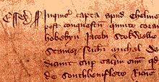
Inquisition into offences committed in Essex, 1381:
And furthermore they all rode armed through the peaceful countryside raising the aforesaid commons against the King and his laws to the Temple of the Priory of St John in England at Cressy and to the house of John Sewale of Coggeshalle, and they levelled the houses of the aforesaid Prior and John and feloniously came upon and took away their goods and chattels. Moreover, they say that on Friday next after the Feast of the Holy Trinity in the fourth year of the reign of the aforesaid King Richard II, John Wiltshire of Lesser Burstede freely and without compulsion lopped off the head of a certain esquire of the Duke of Lancaster called Grenefeld in the City of London.
Original source
iii
Notes:
Image: Inquisition into offences committed in Essex, 1381, Catalogue reference: KB 9/166/2, no. 3, https://discovery.nationalarchives.gov.uk/details/r/C2285593

