Slide 1
How do historians find out what happened in England in 1381?

Slide 2
Let’s review the event that we have looked at.
On the next slide are some of the key events from the traditional interpretation.
Can you arrange them into the correct chronological order?
There are also a couple of new pieces of information that were not in the sources and interpretations that we looked at last lesson.

Slide 3
They managed to break into the Tower of London and killed the Archbishop of Canterbury.
A poll tax was introduced to help fund the war with France, led by John of Gaunt. Rich and poor had to pay the same amount.
Although the King did grant them manumission, he didn’t keep his promise. Leaders were found and executed.
Some people who were involved were later granted pardons.
King Richard II (who was only 14) agreed to meet the rebels and listen to their demands.
They met at Smithfield. During this meeting, the Mayor of London killed Wat Tyler.
They attacked the property of rich people. In London, they even burnt down John of Gaunt’s Savoy Palace.
The King spoke directly to the people and asked them to stay calm. He said that if they went home, he would give them their freedom.
They went to London and attracted more people to join them on the way.
A law called the Statute of Labourers kept wages for peasants low.
People from Kent and Essex decided not to pay. They started to attack rich and powerful people.
Leaders included Wat Tyler and John Ball.
Notes:
Manumission: set free, released from slavery
Statute: another word for a law
Labourers: workers

Slide 4
A law called the Statute of Labourers kept wages for peasants low.
A poll tax was introduced to help fund the war with France, led by John of Gaunt. Rich and poor had to pay the same amount.
People from Kent and Essex decided not to pay. They started to attack rich and powerful people.
Leaders included Wat Tyler and John Ball.
They went to London and attracted more people to join them on the way.
They attacked the property of rich people. In London, they even burnt down John of Gaunt’s Savoy Palace.
They managed to break into the Tower of London and killed the Archbishop of Canterbury.
King Richard II (who was only 14) agreed to meet the rebels and listen to their demands.
They met at Smithfield. During this meeting, the Mayor of London killed Wat Tyler.
The King spoke directly to the people and asked them to stay calm. He said that if they went home, he would give them their freedom.
Although the King did grant them manumission, he didn’t keep his promise. Leaders were found and executed.
Some people who were involved were later granted pardons.
Notes:
CORRECT ORDER

Slide 5

Today we will find out more about the events of 1381, looking at some recent research by historians on the topic.
What else do we need to know or want to find out?

Slide 6
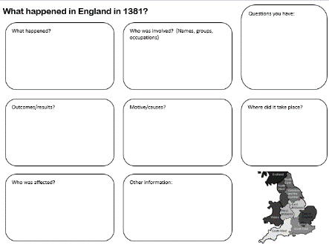

What happened in England in 1381?
We’ll continue to put our findings on to the sheet.
We may need to cross out or add to information as we go. This is absolutely fine and what historians have to do in their work – sometimes new evidence changes things!

Slide 7
How do historians find out what happened?
We’ll start by thinking about how historians find evidence.
Historians often work in archives.
Here we find very old documents and artefacts that have been safely kept over time.
These include official documents (such as laws or court records).
Notes:
Archives: places where historical documents are kept
You may want to have an initial discussion about what ideas students already have about how historians work.

Slide 8
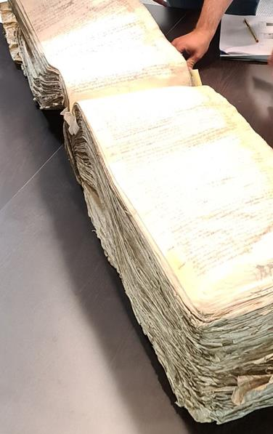
How do historians find out what happened?
These are some Common Pleas rolls.
Each piece of parchment contains lists of pleas that people have made to Parliament.
Notes:
Pleas: an appeal made to a court
Parchment: an early type of paper, made from animal skin
Common Pleas rolls are included to give a sense of scale. Each page has lots of information on it, and students can see how many pages are included.

Slide 9
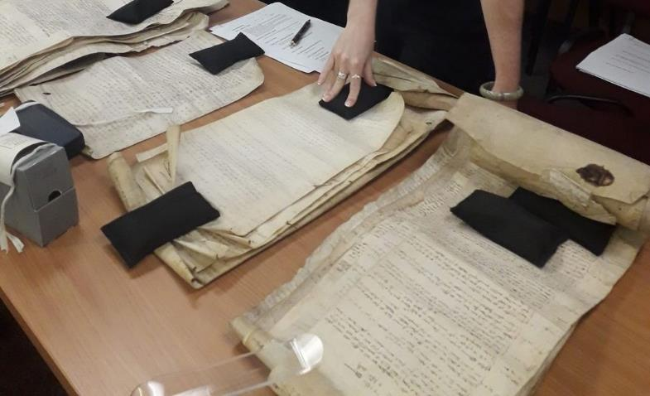
How do historians find out what happened?
Sometimes documents are single pieces of paper, like these. They have been rolled up so that they can be stored easily.
What do you think these black things are?
Notes:
The black things are weights (like little pillows!) to hold down the rolled-up documents. This slide encourages students to think about how documents are stored and used.

Slide 10
How do historians find out what happened?
We’ll watch a short video showing a group of historians working in an archive or record office. They are researching the events of 1381.
Look out for the following:
How are the documents stored?
How do they know where to look for a document?
Notes:
Video: www.youtube.com/watch?v=F9a65eu89Qo
This video shows some of the People of 1381 team visiting the Essex Records Office. Students can watch the first couple of minutes – it may be easier to mute the video so that you can point things out. In particular, you may want to note how documents are stored (boxes, rolled cupboards, classifications). Again, maybe encourage students to think about the scale of historical research: how many documents are in this archive? How many archives are there in the country?

Slide 11
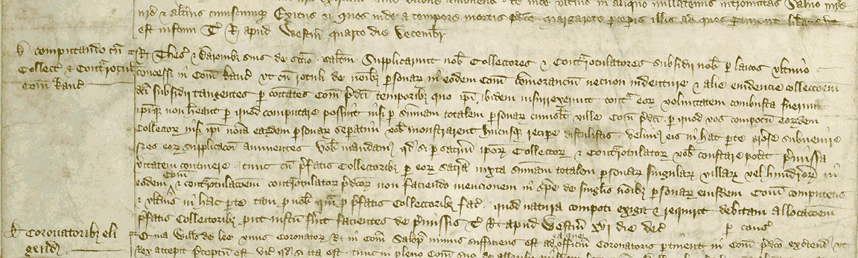
How do historians find out what happened?
We will be looking an extract from this source.
Can you read it? The next slide will zoom in even more...
Notes:
Students will look at the various stages of source analysis, starting with the original image.
Catalogue reference: C 54/221, m. 28 (16 December 1381)
https://webarchive.nationalarchives.gov.uk/ukgwa/20220201204741/https://www.nationalarchives.gov.uk/pathways/citizenship/citizen_subject/peasant.htm

Slide 12
What language is it in?
Is it neat? Can you make out any words?
Notes:
Various prompted stages of analysis. Key points in the source are indicated. Ask students to think about how long this process might take? How many documents might a historian use in their research?

Slide 13
Luckily for us, this one has been transcribed.
What can you work out now?
Rex thesaurio et baronibus suis de scaccarii salutem. Supplicarunt nobis collectores et contrarotulatores subsidii nobis per laicos ultimo concessi in comitatu Kantie ut cum rotuli de nominibus personarum in eodem comitatu commorantium necnon indenture et alie evidencie colleccionem dicti subsidii tangentes per comitates comitatus predicti temporibus quo ipsi ibidem insurrexerunt contra eorum voluntatem combusta fuerunt ipsique non habeant per quod computare possint nisi per summam totalem personarum cuiuslibet ville comitatus predicti per quod vos compotum eorundem collectorum nisi ipsi nomina earundem personarum seperatim vobis monstrarent hucusque recipere distulistis velimus eis in hac parte grosere subvenire nos eorum supplicacioni annuentes. Vobis mandamus quod si per sacramentum ipsorum collectorum et contrarotulatorum vobis constare poterit premissa veritatem continere, tunc cum prefatis collectoribus per eorum sacramentam iuxta summam totalem personarum singularum villarum vel hundredorum in eodem comitatu et contrarocionem contrarotulatorum predictorum non faciendo mencionem in specie de singulis hominibus personarum eiusdem comitatus computetis et ulterius in hac parte tam pro nobis quam pro prefatis collectoribus factas quod natura compoti exigit et requirit debitam allocacionem prefatis collectoribus prout iustum fuerit facientes de premissis. Teste Rege apud Westminster xvi die Decembris. Per Consilio.
Notes:
Transcribed: typed or written up
Transcription: https://webarchive.nationalarchives.gov.uk/ukgwa/20220202001756/https://www.nationalarchives.gov.uk/pathways/citizenship/citizen_subject/transcripts/destruction_lists.htm

Slide 14
Luckily for us, this one has been translated.
What can you work out now?
The King to the Treasurer and the Barons of the Exchequer. Order, upon petition of the collectors and controllers in Kent of the subsidy last granted to the King by laymen, showing that the rolls of names of those dwelling in Kent, the indentures and other evidences concerning the collection were burned by the commons of the county in their late insurrection, and that the collectors have not wherewithal to account but by the sum total of persons of every town, wherefore the Treasurer and the Barons have deferred to receive their account unless they showed severally those persons’ names, if by oath of the collectors and controllers assured that these things are true, to account with the collectors upon oath by the sum total of persons of the towns or hundreds, and by control of the controllers, making no special mention of the names. Witnessed by the King at Westminster, 16 December. By the Council.
Notes:
Translation: https://webarchive.nationalarchives.gov.uk/ukgwa/20220202001756/https://www.nationalarchives.gov.uk/pathways/citizenship/citizen_subject/transcripts/destruction_lists.htm

Slide 15
The key points have been highlighted.
The King to the Treasurer and the Barons of the Exchequer. Order, upon petition of the collectors and controllers in Kent of the subsidy last granted to the King by laymen, showing that the rolls of names of those dwelling in Kent, the indentures and other evidences concerning the collection were burned by the commons of the county in their late insurrection, and that the collectors have not wherewithal to account but by the sum total of persons of every town, wherefore the Treasurer and the Barons have deferred to receive their account unless they showed severally those persons' names, if by oath of the collectors and controllers assured that these things are true, to account with the collectors upon oath by the sum total of persons of the towns or hundreds, and by control of the controllers, making no special mention of the names. Witnessed by the King at Westminster, 16 December. By the Council.

Slide 16
How did the peasants rebel?
Another word for tax
The King to the Treasurer and the Barons of the Exchequer. Order, upon petition of the collectors and controllers in Kent of the subsidy last granted to the King by laymen, showing that the rolls of names of those dwelling in Kent, the indentures and other evidences concerning the collection were burned by the commons of the county in their late insurrection, and that the collectors have not wherewithal to account but by the sum total of persons of every town, wherefore the Treasurer and the Barons have deferred to receive their account unless they showed severally those persons' names, if by oath of the collectors and controllers assured that these things are true, to account with the collectors upon oath by the sum total of persons of the towns or hundreds, and by control of the controllers, making no special mention of the names. Witnessed by the King at Westminster, 16 December. By the Council.
Another word for rebellion
Peasants

Slide 17

What does this tell us about how organised the peasants were?
What does it tell us about their aims?
The King to the Treasurer and the Barons of the Exchequer. Order, upon petition of the collectors and controllers in Kent of the subsidy last granted to the King by laymen, showing that the rolls of names of those dwelling in Kent, the indentures and other evidences concerning the collection were burned by the commons of the county in their late insurrection, and that the collectors have not wherewithal to account but by the sum total of persons of every town, wherefore the Treasurer and the Barons have deferred to receive their account unless they showed severally those persons' names, if by oath of the collectors and controllers assured that these things are true, to account with the collectors upon oath by the sum total of persons of the towns or hundreds, and by control of the controllers, making no special mention of the names. Witnessed by the King at Westminster, 16 December. By the Council.
Does this challenge any aspect of the traditional interpretation?
Notes:
Challenge questions

Slide 18
Remember – historians might use hundreds of sources (maybe even more).
It’s hard work being a historian!

Slide 19
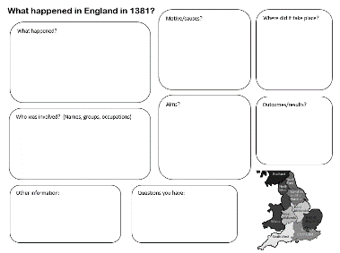
We have the following information to try to answer our remaining questions about the events of 1381.
A list of occupations of people involved
Extra sources
Information about chronicles (a particular type of source – we used extracts from some last lesson)
A database about the people involved in 1381
An interactive map showing what happened and where
https://padlet.com/ha1381/1381-revolt-map-bnofracmmfti1cyc
Information about key figures
Use these to add to your notes
from last lesson.
Notes:
It would be useful to look through the activities beforehand and decide which are most suited to your class. Some will require internet access. More details follow in this presentation for each activity.
For reference, the tasks are listed here, broadly in terms of challenge, with the easiest first.
Key figures
Places
Map
Occupations
Chronicles
Database
Additional source: John Shirley
Additional source: Pleas
Best options for whole-class work (with opportunity for paired discussions): Database and Chronicles
Best options for paired or group work: Occupations, Places, Map

Slide 20
Database: https://data.1381.online

Slide 21
People of 1381 database
A group of historians have recently completed a major project to find out more about what happened in 1381.
They carried out detailed research using hundreds of sources.
Notes:
Website: https://data.1381.online
This is best done as a whole-class activity, followed by individual/paired work to explore the database further. It would be useful to familiarise yourself with the database first of all. The slides give a worked example.

Slide 22
People of 1381 database
They have built a database so that people can now use their research to answer their own questions about the events of 1381.
We are going to look at one example to see how it works.

Slide 23
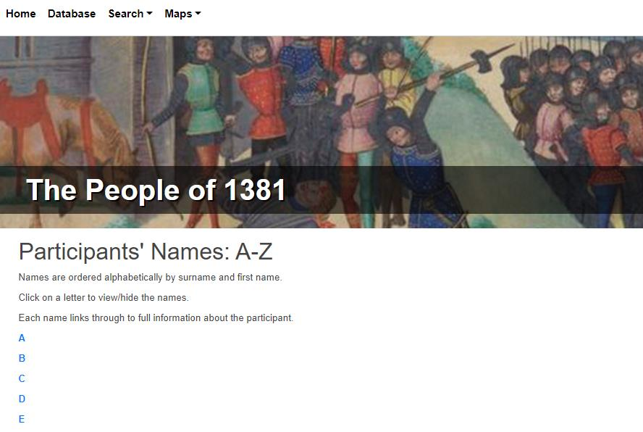
People of 1381 database
We are going to search for a person.

Slide 24
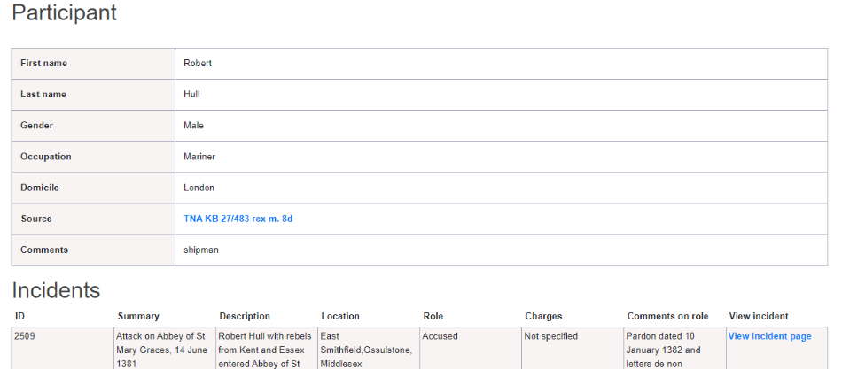
People of 1381 database
Click on H and then scroll down for Robert Hull.
You will also get an idea of how many people are in the database and how many people are involved! You will come to this page....

Slide 25
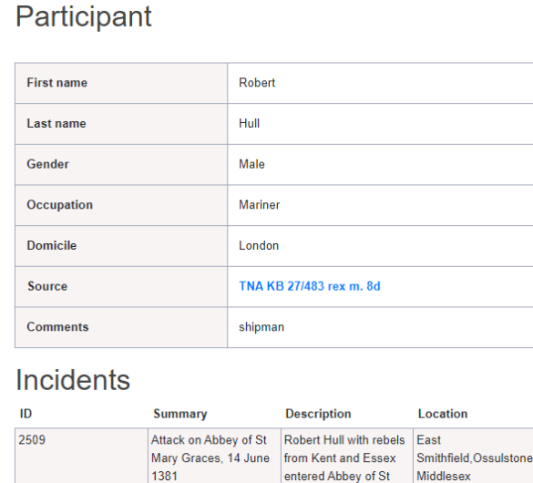
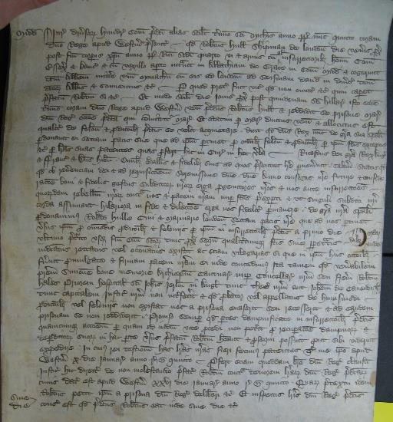
It tells you briefly about the records for the person. If you click on Source, it will take you to details of the document where the historians found out about this person. It may also include an image of the source too – like the one here.

Slide 26
People of 1381 database
You can try searching for people or maybe try the places and see whether anywhere near to you was involved in the Revolt...

Slide 27
Occupations

Slide 28
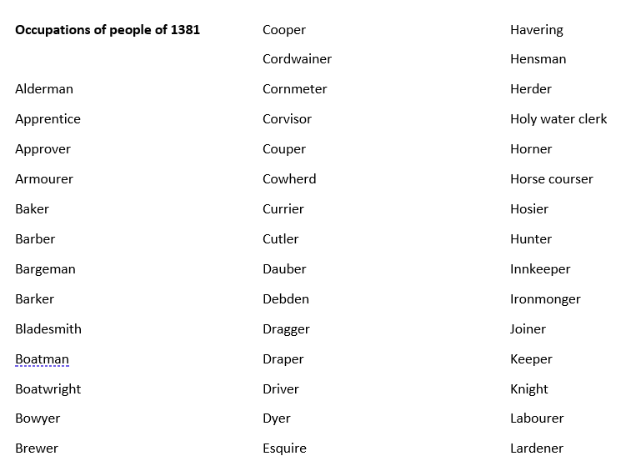
Occupations of people involved
You can pick a couple that you don’t know the meaning of and try to find out what they were.
What can you infer about the number of different jobs?
What can you infer about the type of people involved?
Does this challenge the traditional interpretation in any way?
Notes:
NB: Some occupations we may not be able to work out! Some may also have been spelt incorrectly or differently at the time.
This task aims to get students to think about the type of people involved – it wasn’t just peasants.

Slide 29
Key figures

Slide 30
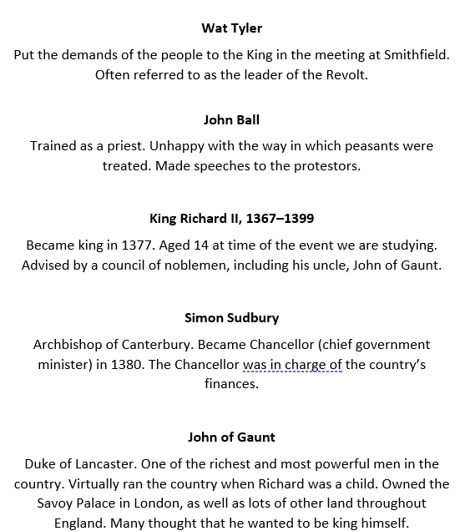
Key figures involved
Which people are rebels?
Can you add any more information to your sheet?
Why might the age of the King be a factor?
Notes:
This provides simple factual information and may be most suited to students who are finding the narrative of events challenging.

Slide 31
Wat Tyler
Put the demands of the people to the King in the meeting at Smithfield. Often referred to as the leader of the Revolt.
John Ball
Trained as a priest. Unhappy with the way in which peasants were treated. Made speeches to the protestors.
King Richard II, 1367–1399
Became king in 1377. Aged 14 at time of the event we are studying. Advised by a council of noblemen, including his uncle, John of Gaunt.
Simon Sudbury
Archbishop of Canterbury. Became Chancellor (chief government minister) in 1380. The Chancellor was in charge of the country’s finances.
John of Gaunt
Duke of Lancaster. One of the richest and most powerful men in the country. Virtually ran the country when Richard was a child. Owned the Savoy Palace in London, as well as lots of other land throughout England. Many thought that he wanted to be king himself.

Slide 32
Map of events

Slide 33
Map of events
The pins show all the places where the Revolt happened. If you click on some of them, you can find out what was happening in different parts of the country.
https://padlet.com/ha1381/1381-revolt-map-bnofracmmfti1cyc
Notes:
This task is to help students to see the geographical range of events – and the fact that it was not just London and the South East. Similarly, encourage students to look at the dates to note how events did not end after Wat Tyler was killed in London.

Slide 34
Extra source 1

Slide 35
What can you work out about events from this source?
Pleas held at Royston on Saturday 6 July 1381 before the aforesaid assigned justices.
Hundreds of Armingford and Stow Longa
Twelve jurors say that William Vicory of Linton and John Webbe of Papworth were felons associated with John Hanchach the chief leader, and John Peper. And that on Saturday 15th June 1381 they were ringleaders in the overthrowing of the buildings of Thomas Haselden, and the selling of his goods and chattels. And they made a public proclamation fomenting oppression and treason, namely on seven occasions or more, in prejudice of the king. And be it known that the said William Vicory gave himself up to prison for these felonies, and remains in the custody of the Sheriff.
Notes:
Key points are highlighted on the next slide. This suggests the local nature of the Revolt and an opportunity to settle scores – they are stealing property from one person.
Original source TNA JUST 1/103 m. 4, http://data.1381.online/projects_database/pr_incidents_new_ro/?action=view&id=3536

Slide 36
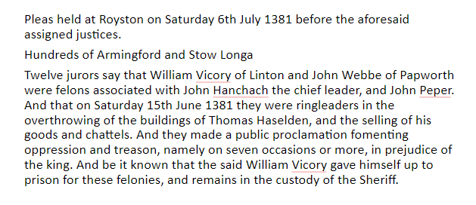
Villages in Cambridgeshire, east of England
A plea to a court
Criminals
Hundreds is the name of a type of court in medieval times
Belongings
Notes:
Key points are highlighted. This suggests the local nature of the Revolt and an opportunity to settle scores – they are stealing property from one person.

Slide 37
Extra source 2

Slide 38
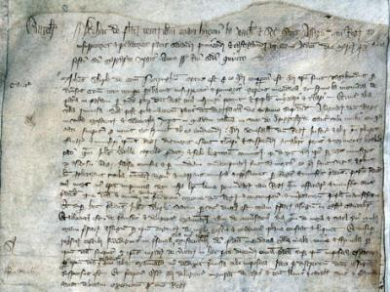
Pleas held before Hugh la Zouche and his associates, justices of the lord king appointed to subdue, punish and chastise rebels and disturbers of the peace in the aforesaid county [Cambridgeshire] on Tuesday immediately before the feast of St Margaret the Virgin, in the fifth year of the reign of King Richard the Second [16 July 1381]
John Shirley of the county of Nottingham was arrested on the grounds that he was clearly wandering through divers counties at the time of the [recent] disturbance, rebellion and mayhem, spreading lies and falsehoods from region to region, likely to cause trouble and to breach the king’s peace and alarm and disturb the people, and for making derogatory statements after the proclamation of the king’s peace on the abovementioned day and year. While the justices of the lord king were present and resident in the town, he said in an inn in Bridge Street in Cambridge, where many people had gathered to hear fresh falsehoods from him, that the stewards of the lord king, his justices and many of his officials were more worthy to be drawn and hanged and suffer the other punishments and tortures prescribed by the law than the priest, John Ball, who had been convicted by law as a traitor and a felon, because he said that [Ball] had been condemned to death by the said ministers, with the assent of the king, falsely, unjustly and maliciously, simply for being a true and honest man, speaking out about the councils and courts of the realm and telling of the injustices and oppressions inflicted by the king and the said ministers upon the people, and his death will not go unpunished, but within a short time will be repaid by the king and his officials and ministers. These words and threats were both injurious to the crown and made to the manifest contempt and alarm of the people. Whereupon the said John Shirley was immediately taken by the sheriff before the said justices in Cambridge castle, where he was interrogated about these matters and closely examined concerning the conduct of his life and his place of residence and also with respect to his status. This information was acknowledged by him before the justices, and it was clearly established that he was of low bearing and estate. In addition trustworthy witnesses were questioned who had been present at the time that he had spoken these lies, evil words, threats and falsehoods, and after they had been sworn to tell the truth about these matters, they gave evidence that all the things that he was alleged to have said, had indeed been said by him, and when he was examined separately, he did not deny the allegations. Therefore, by judgement of the said commissioners, he was hanged. And the escheator was ordered to inquire diligently into his lands and tenements, goods and chattels, and to dispose of them accordingly on behalf of the king.
Original source
Notes:
Image: General oyer and terminer roll, commissions of 1381 to deal with the aftermath of the Peasants’ Revolt, Cambridgeshire roll of indictments, https://webarchive.nationalarchives.gov.uk/ukgwa/20220202123330/https://www.nationalarchives.gov.uk/humanrights/1215-1500/doc-revolt-translation.htm

Slide 39
Pleas held before Hugh la Zouche and his associates, justices of the lord king appointed to subdue, punish and chastise rebels and disturbers of the peace in the aforesaid county [Cambridgeshire] on Tuesday immediately before the feast of St Margaret the Virgin, in the fifth year of the reign of King Richard the Second [16 July 1381]
John Shirley of the county of Nottingham was arrested on the grounds that he was clearly wandering through divers counties at the time of the [recent] disturbance, rebellion and mayhem, spreading lies and falsehoods from region to region, likely to cause trouble and to breach the king's peace and alarm and disturb the people, and for making derogatory statements after the proclamation of the king's peace on the abovementioned day and year. While the justices of the lord king were present and resident in the town, he said in an inn in Bridge Street in Cambridge, where many people had gathered to hear fresh falsehoods from him, that the stewards of the lord king, his justices and many of his officials were more worthy to be drawn and hanged and suffer the other punishments and tortures prescribed by the law than the priest, John Ball, who had been convicted by law as a traitor and a felon, because he said that [Ball] had been condemned to death by the said ministers, with the assent of the king, falsely, unjustly and maliciously, simply for being a true and honest man, speaking out about the councils and courts of the realm and telling of the injustices and oppressions inflicted by the king and the said ministers upon the people, and his death will not go unpunished, but within a short time will be repaid by the king and his officials and ministers. These words and threats were both injurious to the crown and made to the manifest contempt and alarm of the people. Whereupon the said John Shirley was immediately taken by the sheriff before the said justices in Cambridge castle, where he was interrogated about these matters and closely examined concerning the conduct of his life and his place of residence and also with respect to his status. This information was acknowledged by him before the justices, and it was clearly established that he was of low bearing and estate. In addition trustworthy witnesses were questioned who had been present at the time that he had spoken these lies, evil words, threats and falsehoods, and after they had been sworn to tell the truth about these matters, they gave evidence that all the things that he was alleged to have said, had indeed been said by him, and when he was examined separately, he did not deny the allegations. Therefore, by judgement of the said commissioners, he was hanged. And the escheator was ordered to inquire diligently into his lands and tenements, goods and chattels, and to dispose of them accordingly on behalf of the king.
Notes:
This suggests how worried the authorities were in the aftermath of the events in London. John Shirley is arrested and executed for talking in a tavern, and does not even have a full trial. It also shows how rebels were moving around the country

Slide 40
Chronicles

Slide 41
Chronicles
Chronicles are contemporary accounts of events. They are also sometimes called annals. They tend to have a narrative structure – they tell the story of events in each year in chronological order.
However, although they are often written at the time of events, this doesn’t mean that the author was present at events. We need to think about how well informed the author is.
There are four main chronicles that historians use when studying the events of 1381. It is important to note that they do not all agree on events. We will look at each one in turn.
Notes:
Information relating to the chronicles generally, and then the four main chronicles about the event, plus questions to think about. Print slides 42–45 for students.

Slide 42
Chronicles: Jean Froissart’s Chronicles
Although not English, Froissart is a very important source for this time period. His work was highly regarded at the time, and is still considered very useful today.
He travelled around the country, spent time in London and interviewed lots of people (e.g. politicians and soldiers) about the events of which he wrote. His work has information from people who were with the King during events. It does contain some inaccuracies.

Slide 43
Chronicles: Thomas Walsingham’s Chronica Maiora
Thomas Walsingham was a monk from the Abbey of St Albans. There was a tradition of monks from this abbey writing a chronicle.
St Albans is 20 miles from London and was an important stopping-off point on journeys to and from the capital. In this way, monks were able to keep up to date with news (and gossip) from London.
It is important to note that the Abbey of St Albans was attacked during the events of 1381. This will undoubtedly have affected Walsingham’s view of events.
Walsingham did witness some of the events that he discusses, and will have seen some of the documents he talks about. However, he was keen to discredit the rebels.

Slide 44
Chronicles: Henry Knighton
Knighton was based in Leicester, but does reproduce some documents from the time and vividly describes the panic in Leicester.

Slide 45
Chronicles: Anonimalle Chronicle
This was written within a few years of the Revolt. We think that it was probably written by someone based in York.
It is traditionally considered the most accurate of the chronicles and the most sympathetic to the rebels.

Slide 46
Chronicles
The chronicles do tend to have a particular point of view or ‘side’. Whose do you think it is? None of them were impartial, and most did not present the rebels in a positive light. They also tend to focus on events in London.
How does this affect our use of the chronicles?
What other evidence might we need to balance them out?
With your new knowledge about the chronicles, go back to the evidence that we used last lesson – does this change anything?

Slide 47
What happened in 1381?
Last lesson, we focused on the traditional interpretation.
Have we discovered anything new from the more recent research?
There were a variety of causes.
The leaders were Wat Tyler and John Ball.
They had no clear aim.
The peasants rebelled violently against the King.
It was mainly in London.
It was widespread and serious.
It was unsuccessful.

Slide 48
What happened in 1381?
These are some of the key findings from the new research:
There was a variety of different types of people involved.
It was much more organised than previously thought.
It was a hugely significant event that worried the government greatly.
It varied from place to place and the specific causes were often more to do with local area issues.
There was no single leader.
Notes:
It is worth noting that some of the new research is possible because of technology – historians can now use databases, so can easily cross-reference a huge amount of data.

Slide 49

Having done more research, what do we know as a class? How certain are we?
There will be some things about which you might be more certain than others – just as real historians would be.
Notes:
Students should now reflect on what they have found out in this lesson. This activity is to help them to realise that history is not always clear-cut, and that historians don’t always have all the evidence that they need.

Slide 50
Who?
What?
Outcomes?
Very certain
Not certain/
need more information

Slide 51
How do historians find out about the past?
So how do historians find out about events of 1381?
How is technology helping historians to find out more?
Why is it hard to discover what really happened in 1381?
Notes:
If students are thinking about why it is hard to find out about 1381, they may want to consider:
How do we find the voices of the past? Literacy, survival of materials, etc.
‘Fake news’ today and the media – do we trust them?
How much was suppressed at the time?
How much evidence has just been lost over time?

Slide 52
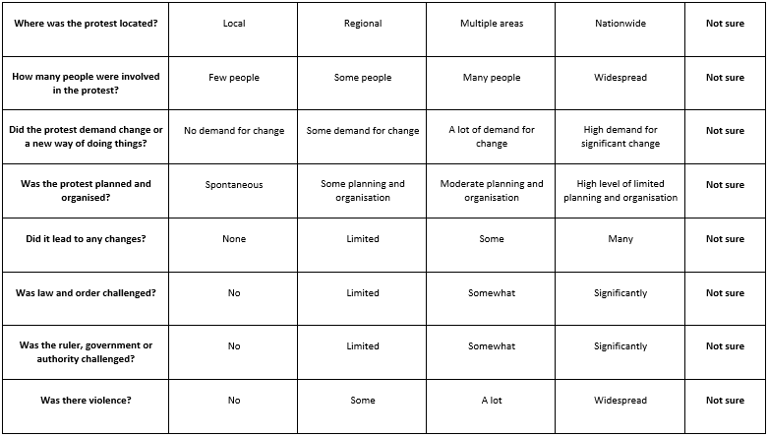

What happened in England in 1381?
Is the term ‘Peasants’ Revolt’ accurate? Or do you think it should be called something else?
Notes:
Use the Lesson 2 protest grid for this optional activity.

